Slide 1
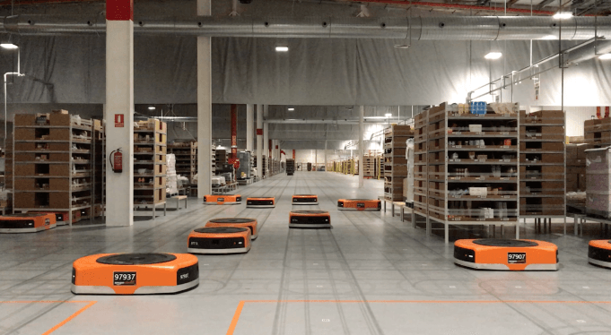
Amazon Robotics machines in a Amazon warehouse
Collision avoidance and coordination for a fleet of robots
Luca Marseglia

Slide 2
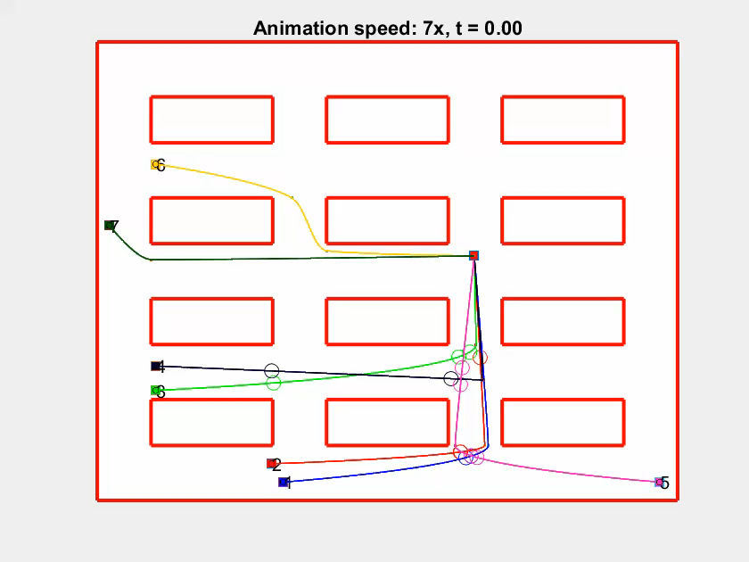
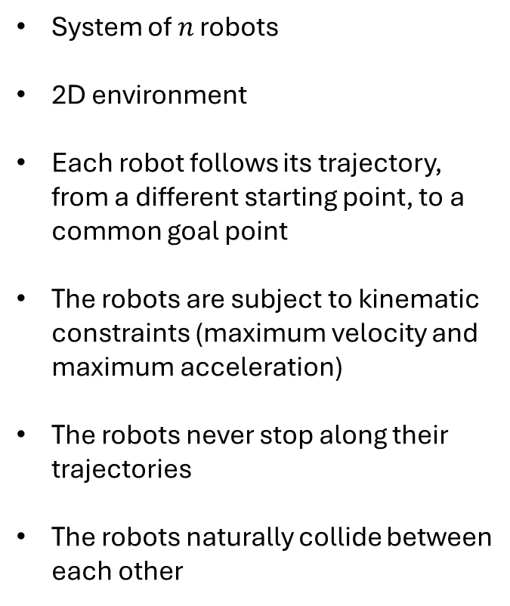
Scenario
System of $n$ robots
2D environment
Each robot follows its trajectory, from a different starting point, to a common goal point
The robots are subject to kinematic constraints (maximum velocity and maximum acceleration)
The robots never stop along their trajectories
The robots naturally collide between each other
2024 October | Slide 2

Slide 3
Goal
To produce an algorithm that adjusts the velocities of the robots to avoid collisions, according to a safety margin
Minimize the total task time and the total energy spent by the system
Constraints
Kinematic constraints (maximum velocity and maximum acceleration)
The geometric path is produced through the CDT-RRT* algorithm, and cannot be modified
2024 October | Slide 3

Slide 4
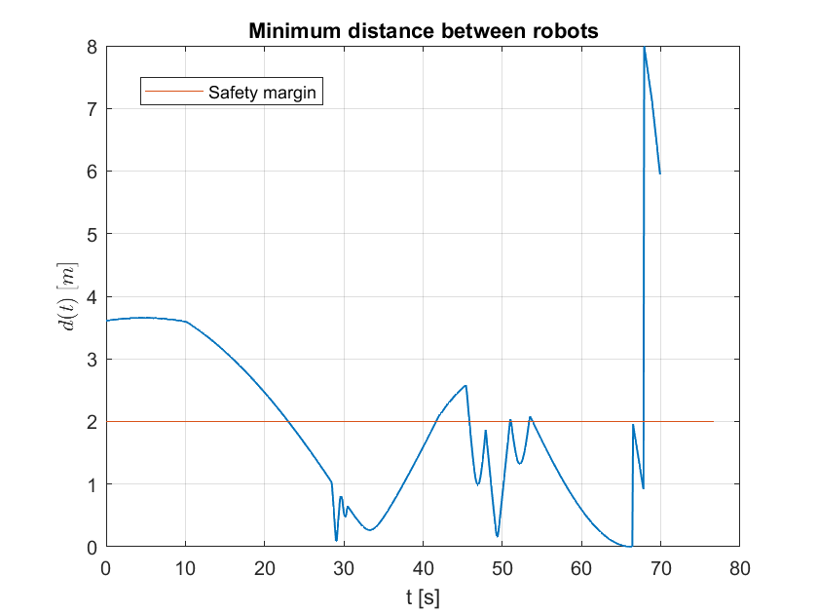
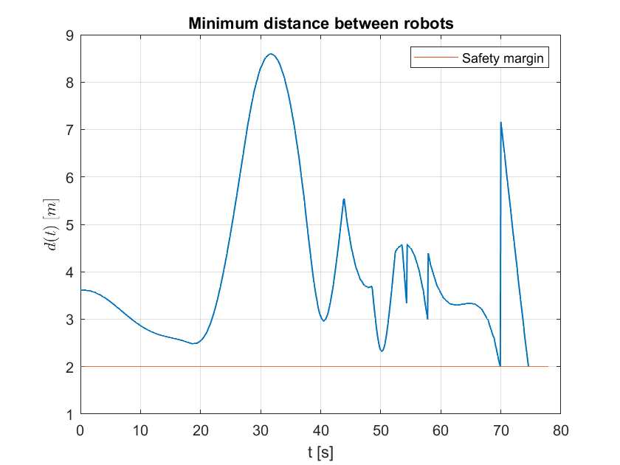
Goal
Before
After
2024 October | Slide 4

Slide 5
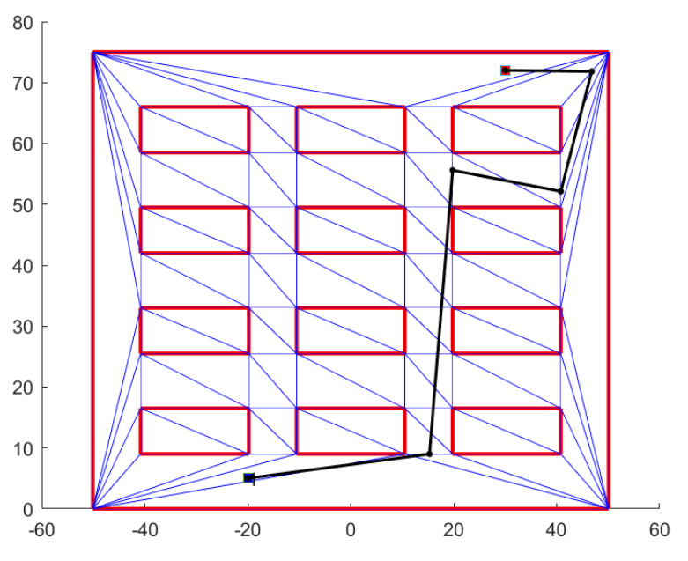
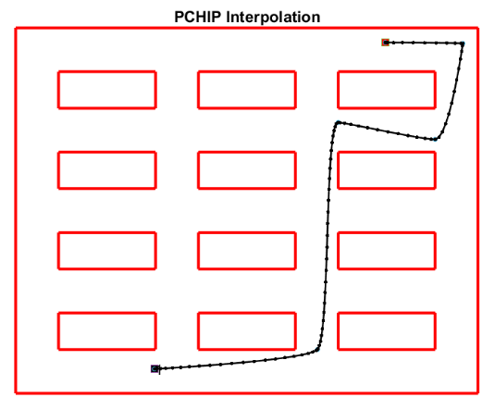
Path interpolation
2024 October | Slide 5

Slide 6
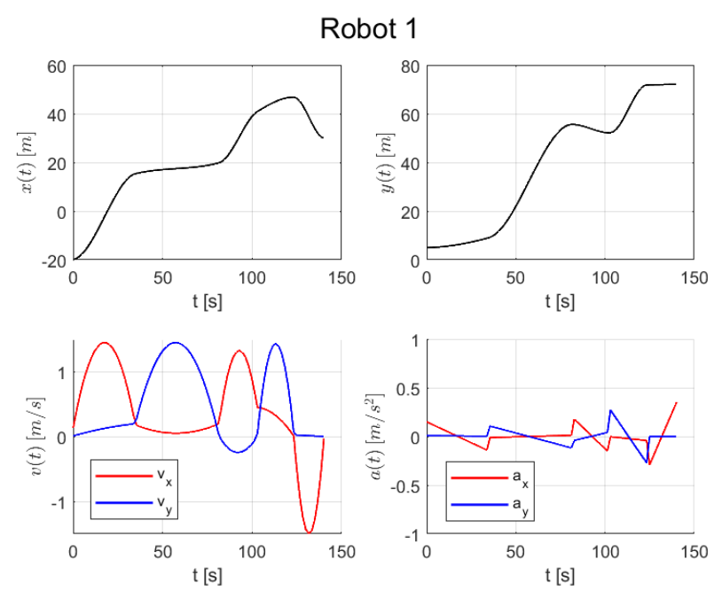
Trajectory generation
2024 October | Slide 6

Slide 7
Proposed approaches
Reduced Brute-force Approach | Genetic Algorithm
 | Single-objective |  | Multi-objective
Prioritized planning
 | Maximum velocities | Slow-down segment | Slow-down segment
2024 October | Slide 7

Slide 8
Reduced Brute-force Approach | Genetic Algorithm
 | Single-objective |  | Multi-objective
Prioritized planning
 | Maximum velocities | Slow-down segment | Slow-down segment
2024 October | Slide 8

Slide 9
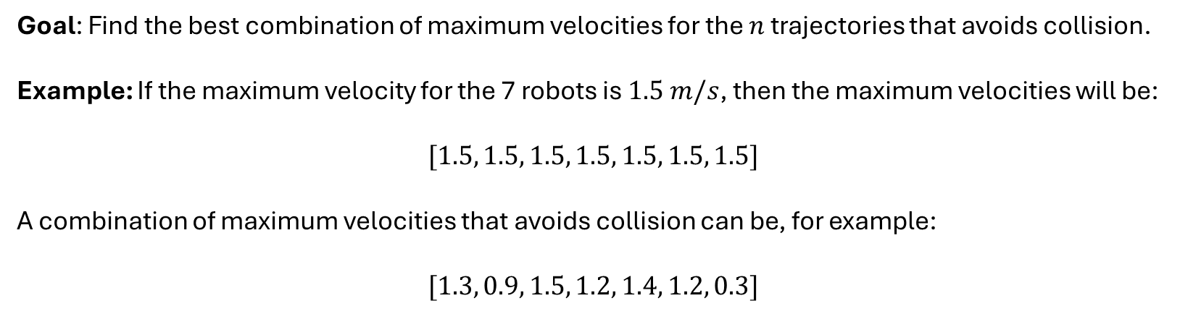
Brute-force approach
Goal: Find the best combination of maximum velocities for the $n$ trajectories that avoids collision.
Example: If the maximum velocity for the 7 robots is $1.5 m/s$, then the maximum velocities will be:
$$[1.5, 1.5, 1.5, 1.5, 1.5, 1.5, 1.5]$$
A combination of maximum velocities that avoids collision can be, for example:
$$[1.3, 0.9, 1.5, 1.2, 1.4, 1.2, 0.3]$$
2024 October | Slide 9

Slide 10
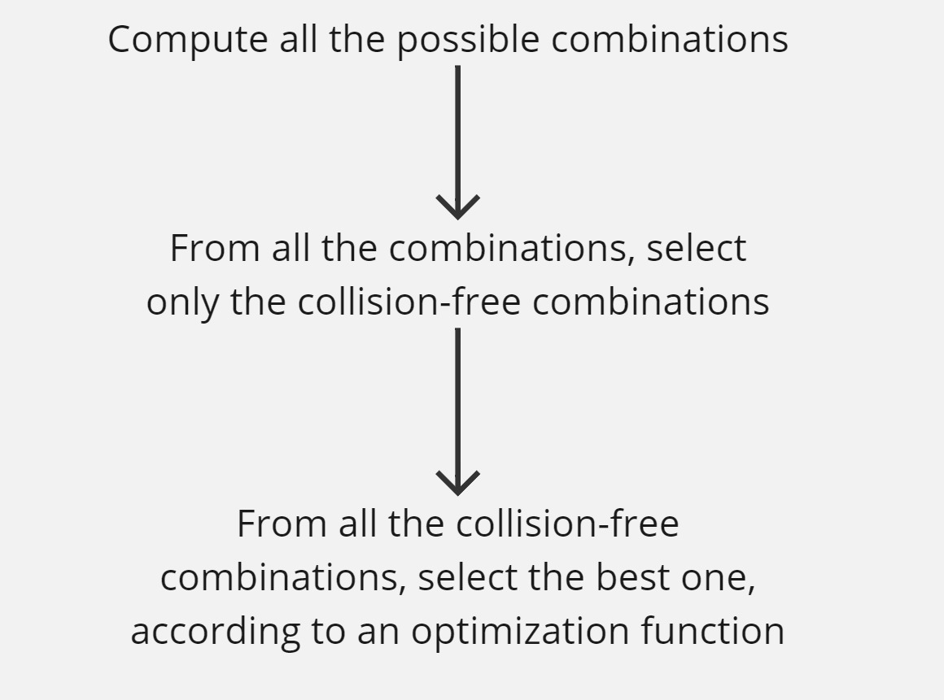
Brute-force approach
2024 October | Slide 10

Slide 11
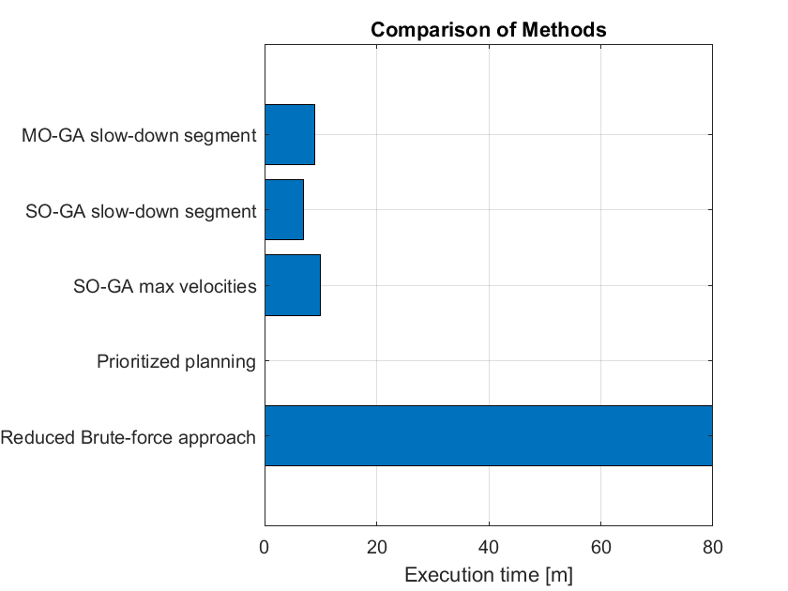
Drawbacks
The execution time increases exponentially with the number of robots.
Does not guarantee the optimal solution
2024 October | Slide 11

Slide 12
Proposed approaches
Reduced Brute-force Approach | Genetic Algorithm
 | Single-objective |  | Multi-objective
Prioritized planning
 | Maximum velocities | Slow-down segment | Slow-down segment
2024 October | Slide 12

Slide 13
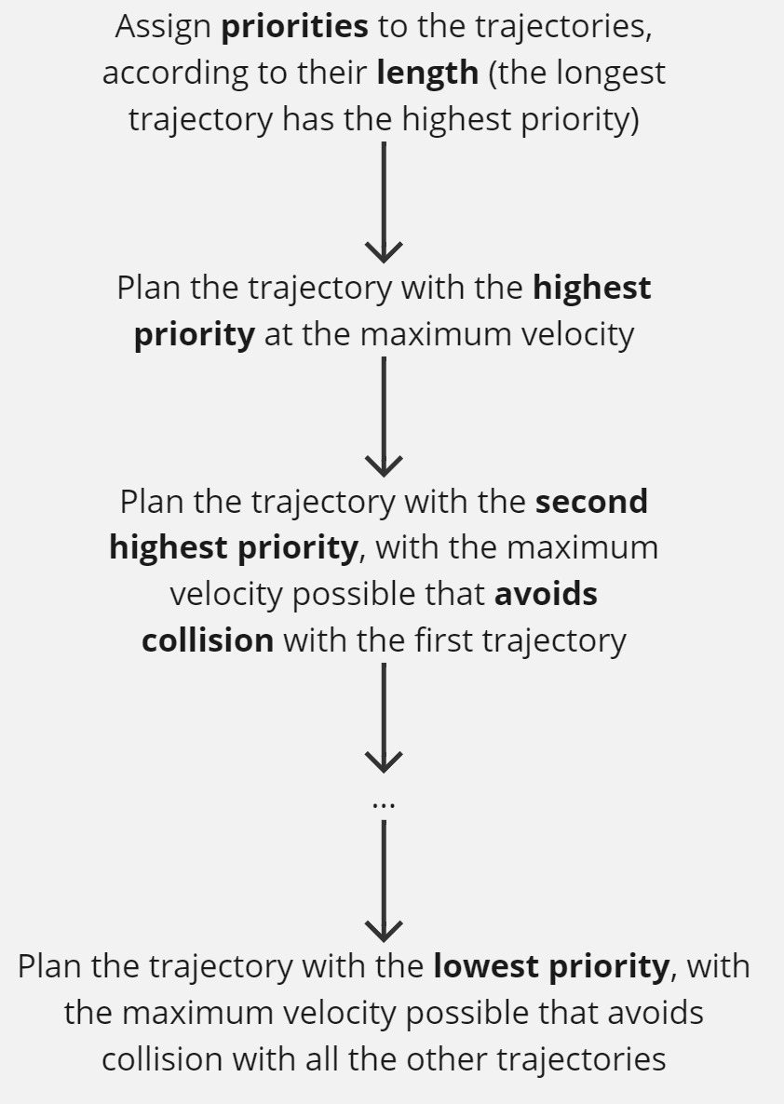
Prioritized planning
2024 October | Slide 13

Slide 14
Pros and cons
Fastest execution time among all the approaches
The quality of the planning depends on the chosen heuristic, and no optimization is performed
2024 October | Slide 14

Slide 15
Reduced Brute-force Approach | Genetic Algorithm
 | Single-objective |  | Multi-objective
Prioritized planning
 | Maximum velocities | Slow-down segment | Slow-down segment
2024 October | Slide 15

Slide 16
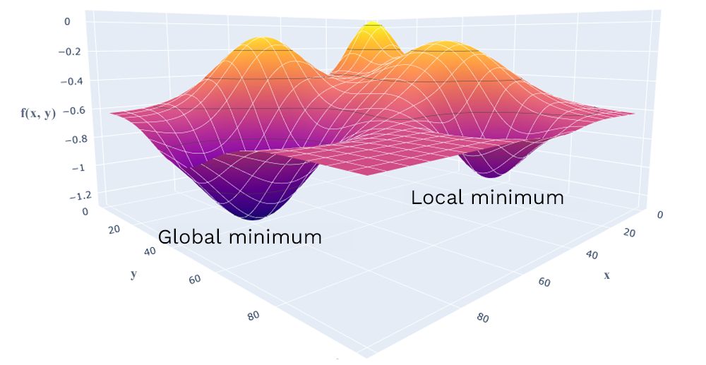
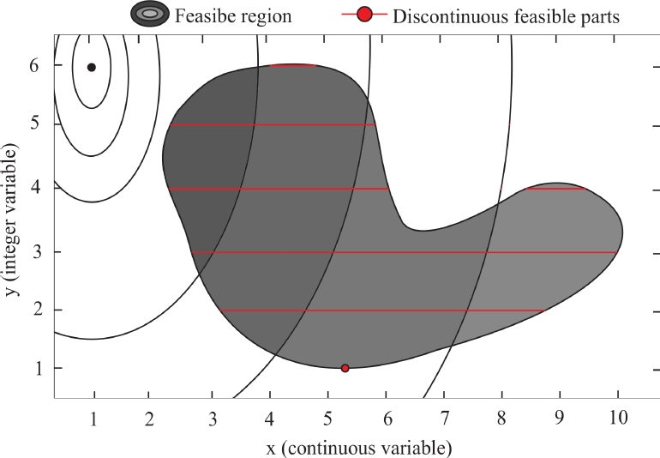
Genetic Algorithm
Global optimization
Mixed-integer Nonlinear optimization
2024 October | Slide 16

Slide 17
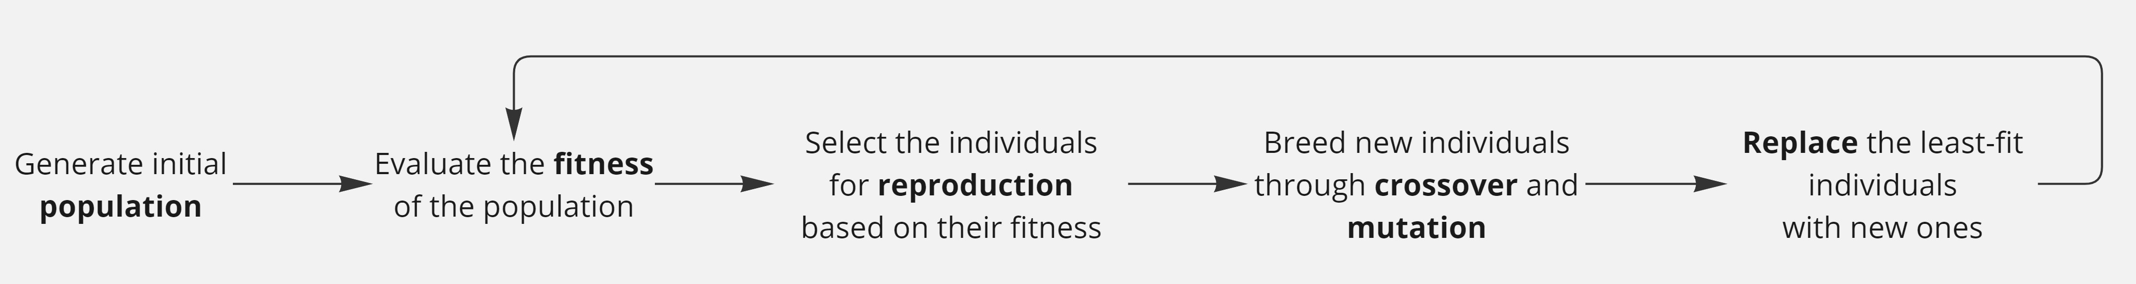
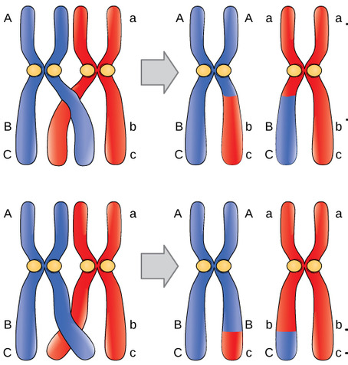
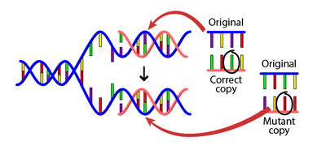
Genetic Algorithm
Crossover
Mutation
2024 October | Slide 17

Slide 18
Crossover
n = 3
Parent A
Parent B
1.23 | 0.81 | 1.45
0.72 | 0.99 | 1.34
Mask
0.3 | 0.2 | 0.8
Threshold = 0.5
Child
1.23 | 0.81 | 1.34
2024 October | Slide 18

Slide 19
Mutation
Parent
1.23 | 0.81 | 1.45
Mask
0.3 | 0.1 | 0.7
Rate = 0.2
Child
1.23 | 1.11 | 1.45
2024 October | Slide 19

Slide 20

Generations
generation k
generation k+1
Elitism: 10%
Crossover Fraction: 80%
2024 October | Slide 20

Slide 21
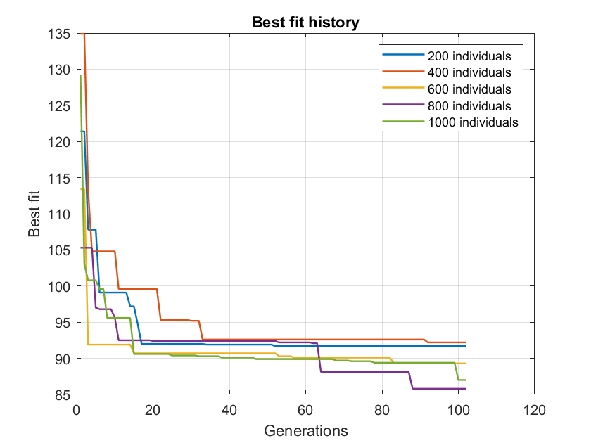
Generations
2024 October | Slide 21

Slide 22
Reduced Brute-force Approach | Genetic Algorithm
 | Single-objective |  | Multi-objective
Prioritized planning
 | Maximum velocities | Slow-down segment | Slow-down segment
2024 October | Slide 22

Slide 23
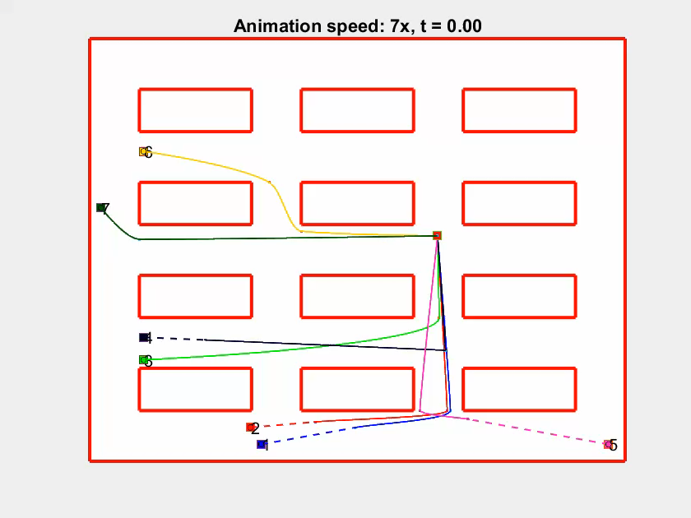
Slow-down segment approach
2024 October | Slide 23

Slide 24
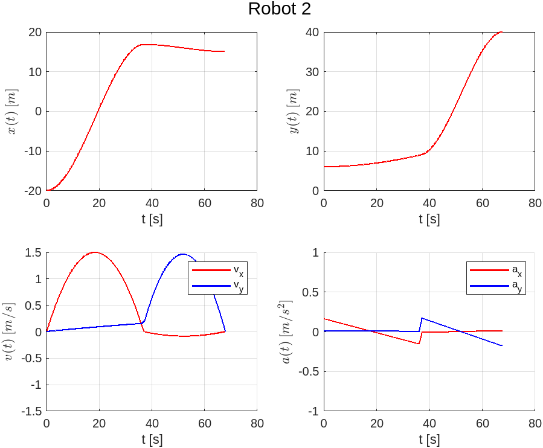
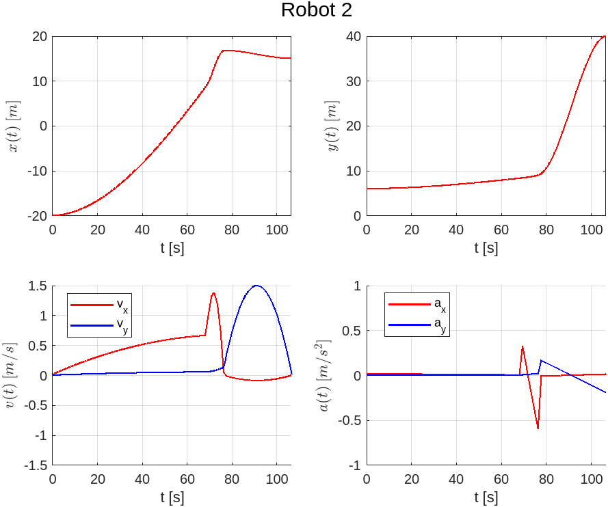

Slow-down segment approach
2024 October | Slide 24

Slide 25

Maximum velocities approach
Solution vector:
$$v_{1}$$ | $$v_{2}$$ | $$v_{3}$$
Slow-down segment approach
Solution vector:
$$L_{1}$$ | $$α_{1}$$ | $$d_{1}$$ | $$L_{2}$$ | $$α_{2}$$ | $$d_{2}$$ | $$L_{3}$$ | $$α_{3}$$ | $$d_{3}$$
Robot 1
Robot 2
Robot 3
2024 October | Slide 25

Slide 26
Reduced Brute-force Approach | Genetic Algorithm
 | Single-objective |  | Multi-objective
Prioritized planning
 | Maximum velocities | Slow-down segment | Slow-down segment
2024 October | Slide 26

Slide 27
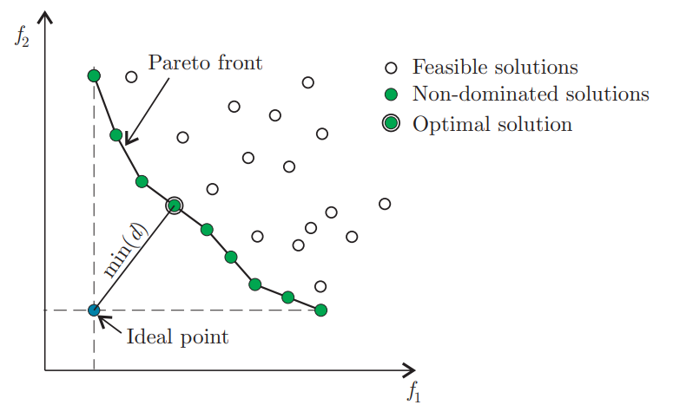
Multi-objective optimization (time + energy)
The two objective functions contradict each other:
a lower energy consumption implies a higher finish time
Energy
consumption
Finish time
2024 August | Slide 27

Slide 28
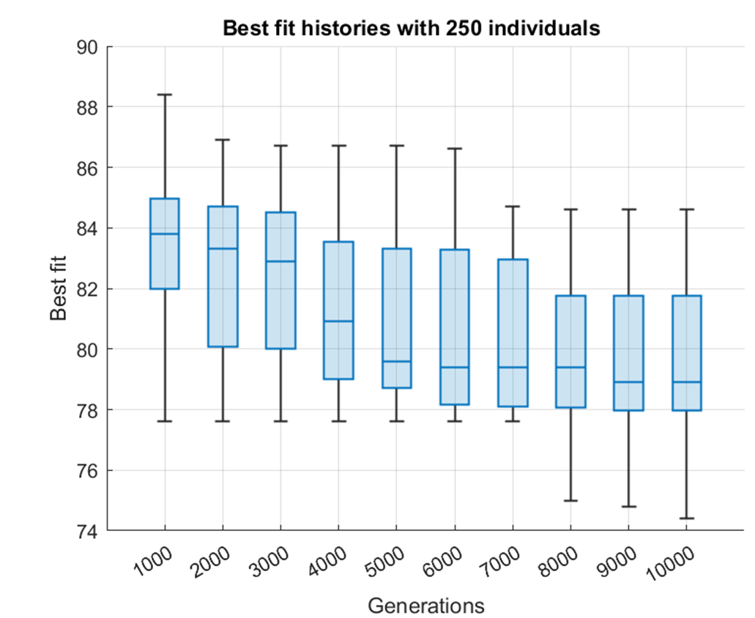
Faced issues
Slow execution times
Divergence of the results
Over different executions
With the same parameters
2024 August | Slide 28

Slide 29
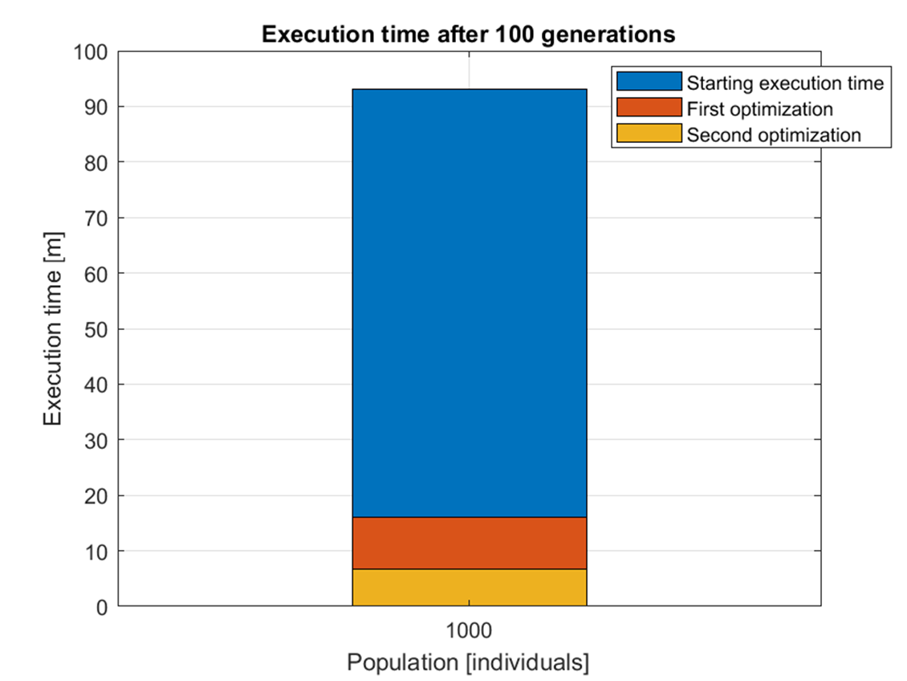
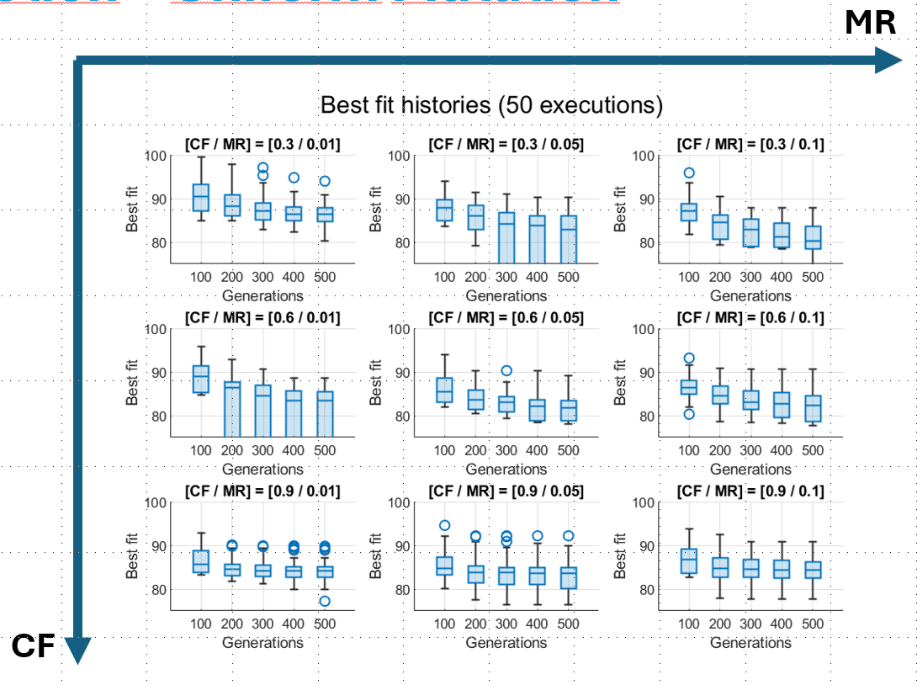
Solutions
Optimization of the code
Tuning of the parameters
(Population size,
Number of generations,
Crossover fraction,
Mutation rate)
2024 August | Slide 29

Slide 30
Roadmap
Production of the final results
Finalization of the thesis
Paper (?)
2024 August | Slide 30

